Slide 1
Mohamed Hesham Ahmed
ID : 202401263
Image-Based Text Steganography Using Basic Python
Coursework Title: Steganography Application – Python Implementation

Slide 2
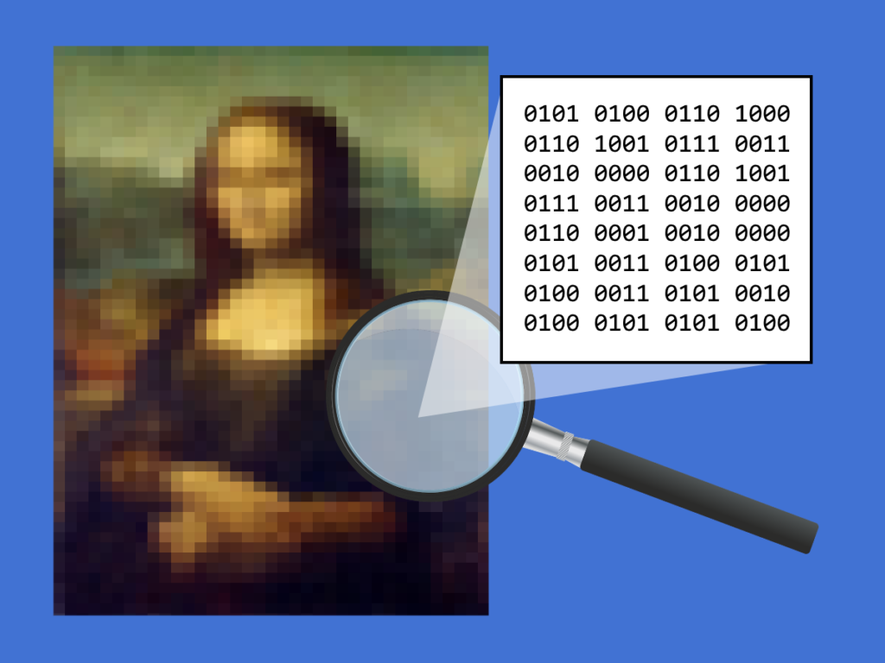
What is steganography?
  Came from Greek work ‘steganos’ and ‘graphein’
  It is not cryptography

Slide 3
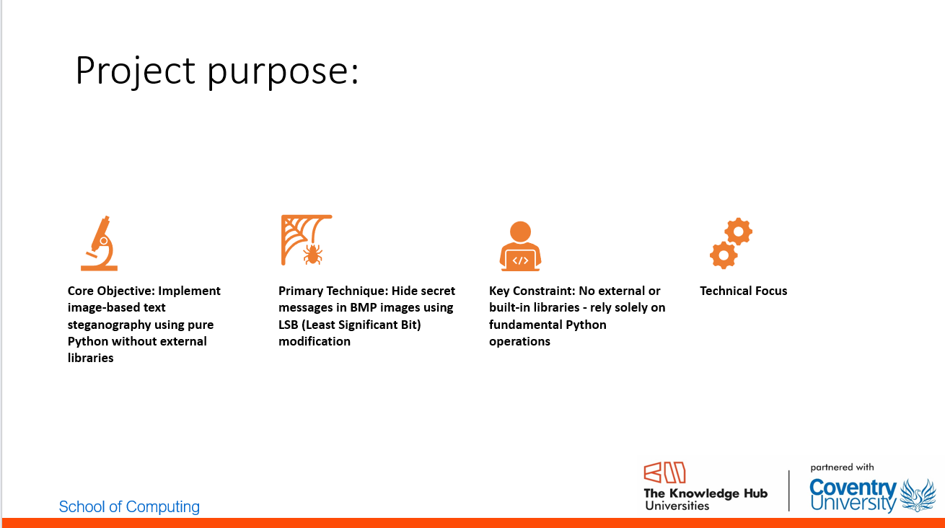

Slide 4
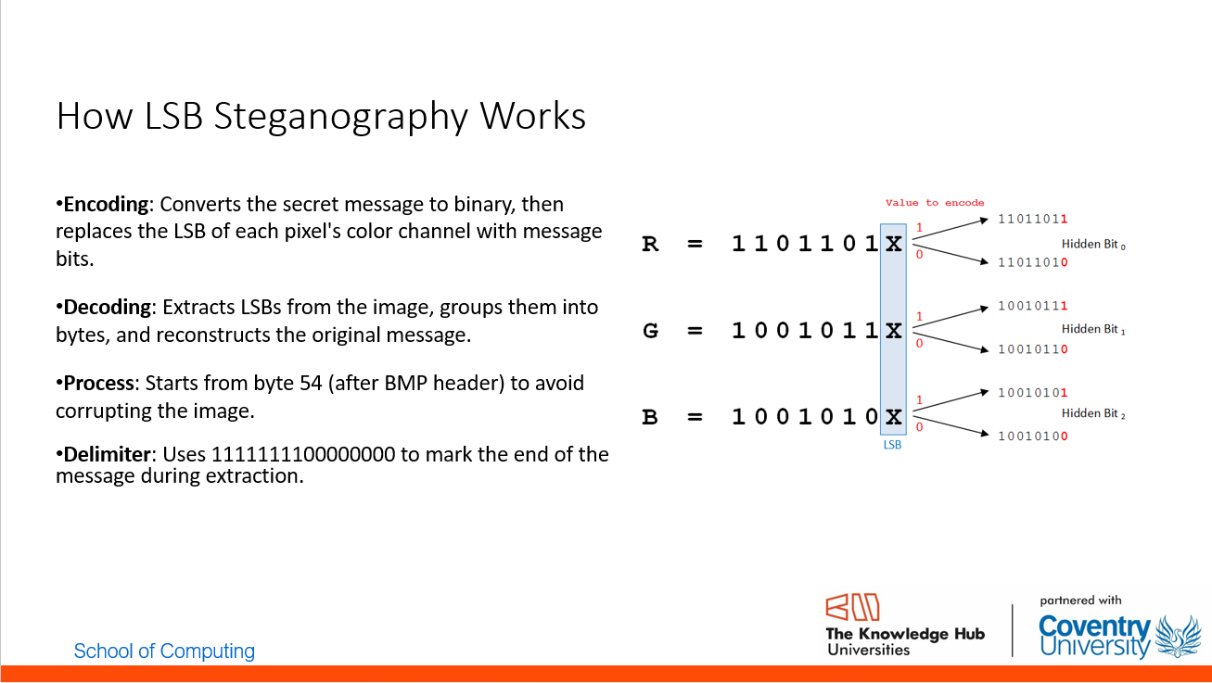
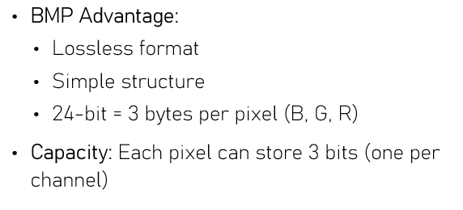

Slide 5
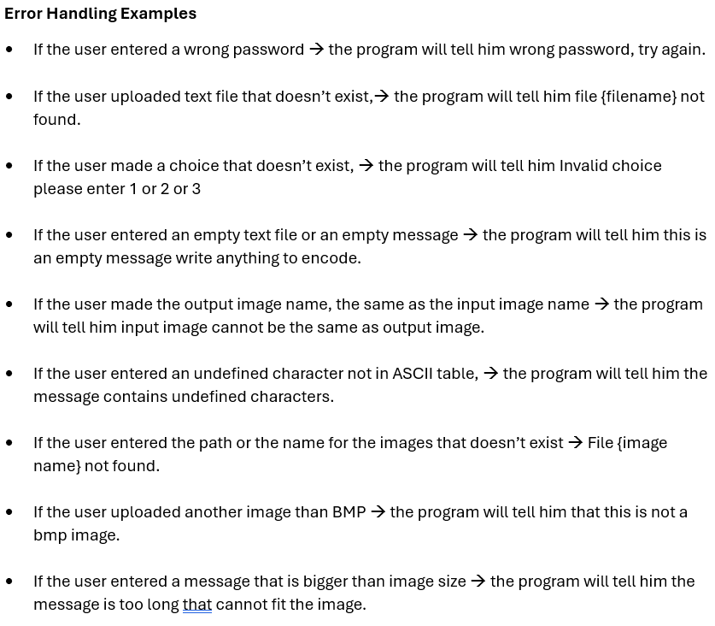


Slide 6
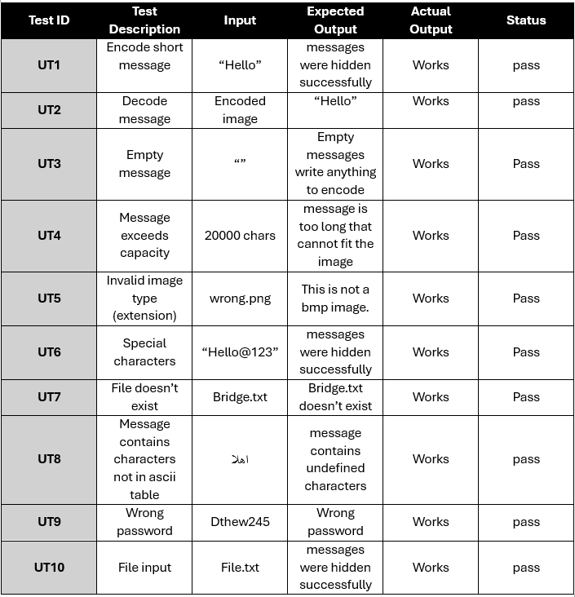
Unit Testing Table

Slide 7
Version Control Repository:
GitHub URL: https://github.com/booka214235/Steganography.git
ppt URL: https://github.com/booka214235/Steganography.git

Slide 8
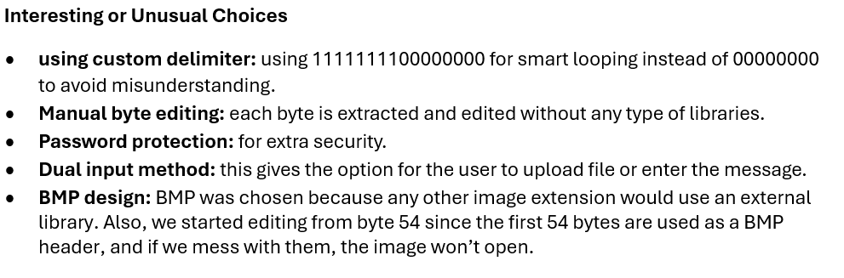

Slide 9
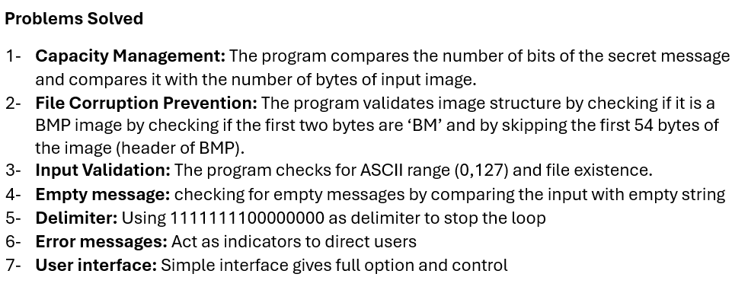

Slide 10
Time Complexity
Encoding: O(n) — where *n* is the message length in bits.
Decoding: O(m) — where *m* is the number of bytes processed until delimiter.
Both are linear and efficient for practical use.

